Slide 1

Smart garden monitoring system
In the ever-evolving realm of modern agriculture and horticulture, the integration of smart technologies has become pivotal for cultivating healthier, more robust gardens. A prime example of this technological infusion is the implementation of a Smart Garden Monitoring System.

Slide 2
WHY Smart Garden Monitoring
Optimal Growth Conditions:
Maintain ideal air temperature, humidity, and soil moisture for healthy plant growth.
Water Efficiency:
Prevent water wastage with soil moisture sensors, ensuring precise watering.
Prevent Plant Stress:
Avoid overwatering or underwatering by receiving real-time alerts and adjusting conditions accordingly.
Remote Monitoring:
Monitor and control the garden remotely via an OLED display or mobile app.
Data Analysis:
Log and analyze historical data for better garden management.

Slide 3
Energy-Efficient Automation:
Operate efficiently with automated controls and energy conservation.
Educational Tool:
Learn about plant care through real-time data and visual representation.
Customization and Scalability:
Tailor the system to specific needs and easily expand with additional features.
Increased Productivity:
Contribute to higher productivity and yield in gardens or agricultural settings.

Slide 4
Components
Ardiuno UNO
BreadBoard
Soil Moisture sensor
OLED
DHT 11

Slide 5
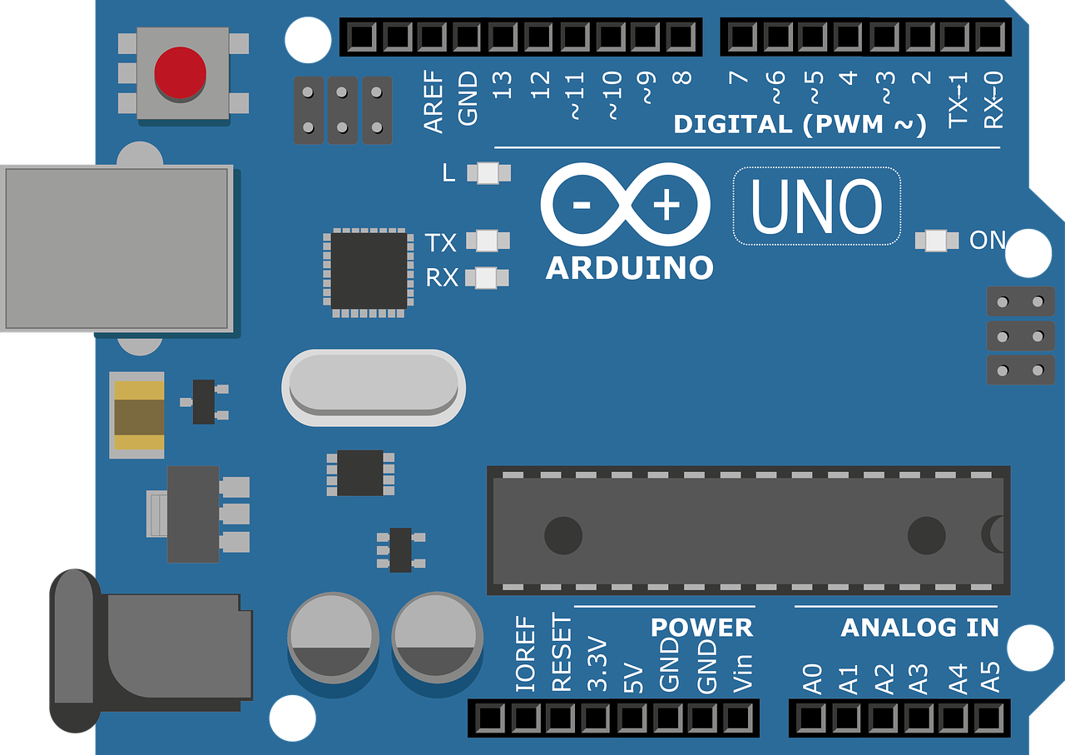
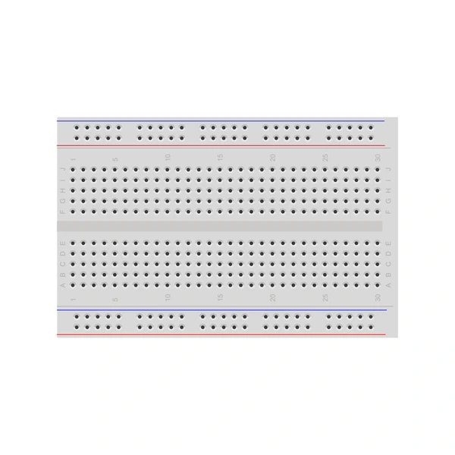
BreadBord
Ardiuno UNO
Arduino Uno is a microcontroller board based on the ATmega328P (datasheet). It has 14 digital input/output pins (of which 6 can be used as PWM outputs), 6 analog inputs, a 16 MHz ceramic resonator (CSTCE16M0V53-R0), a USB connection, a power jack, an ICSP header and a reset button.
A breadboard (sometimes called a plugblock) is used for building temporary circuits. It is useful to designers because it allows components to be removed and replaced easily. It is useful to the person who wants to build a circuit to demonstrate its action, then to reuse the components in another circuit.

Slide 6
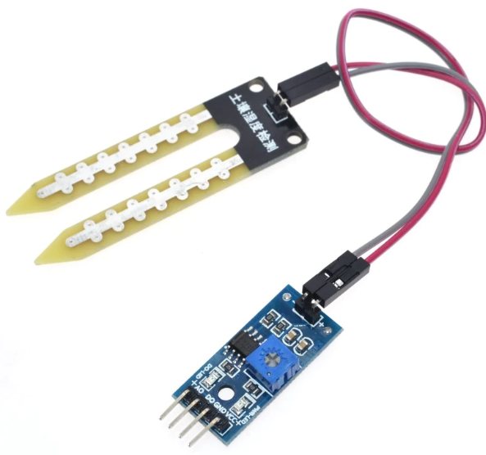
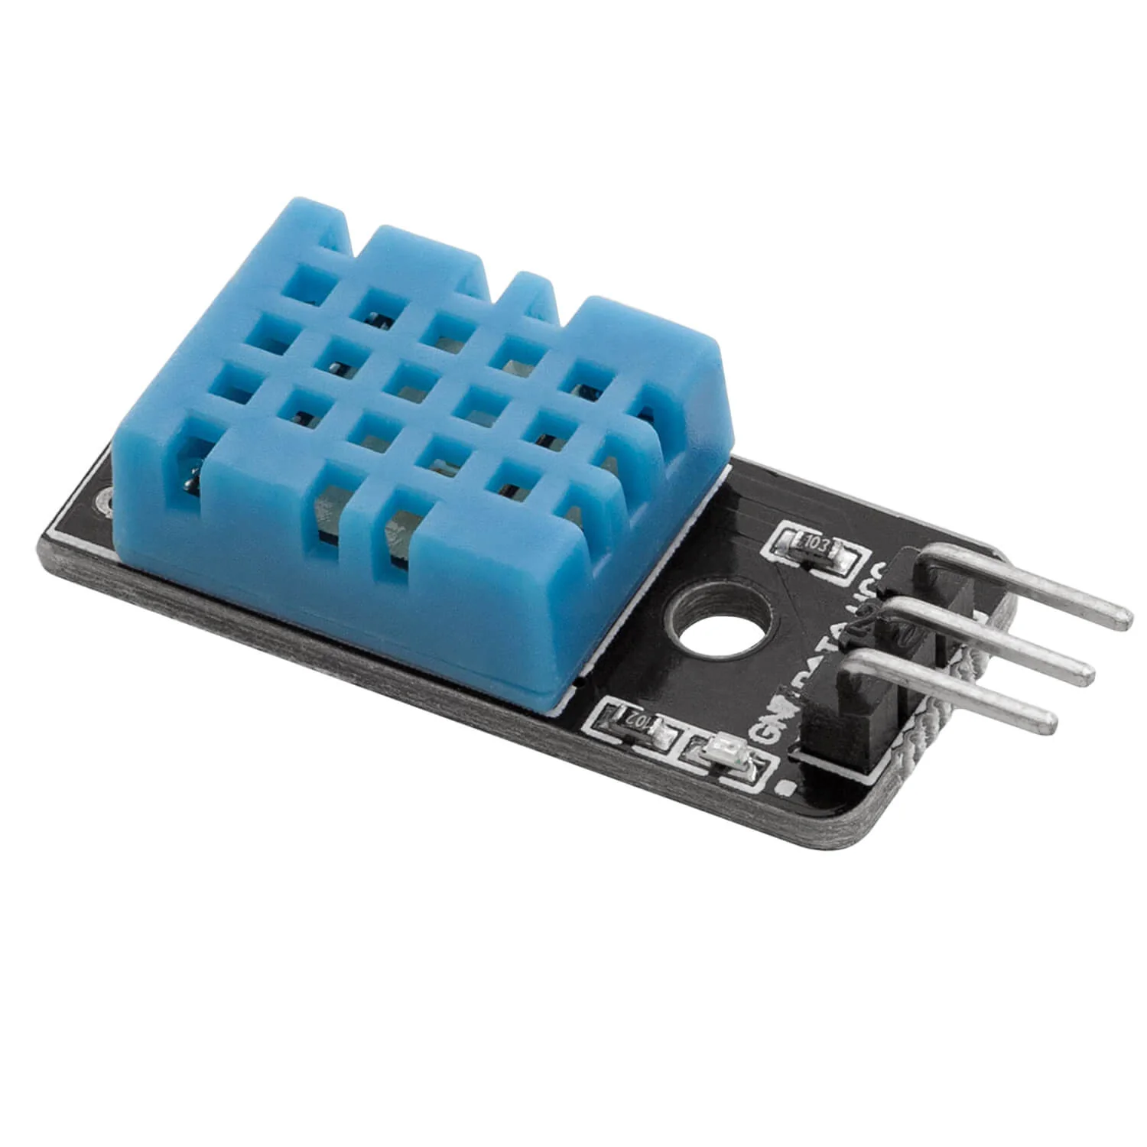
Soil moisture sensor
Sensors
DHT 11 sensor
Soil moisture sensors (SMSs) measure soil moisture at the root zone and regulate the existing conventional irrigation timer, resulting in considerable water savings when installed and used properly. A customized soil water content threshold is set, allowing for dryer or wetter soil condition.
The DHT11 is a basic, ultra low-cost digital temperature and humidity sensor. It uses a capacitive humidity sensor and a thermistor to measure the surrounding air and spits out a digital signal on the data pin (no analog input pins needed).

Slide 7
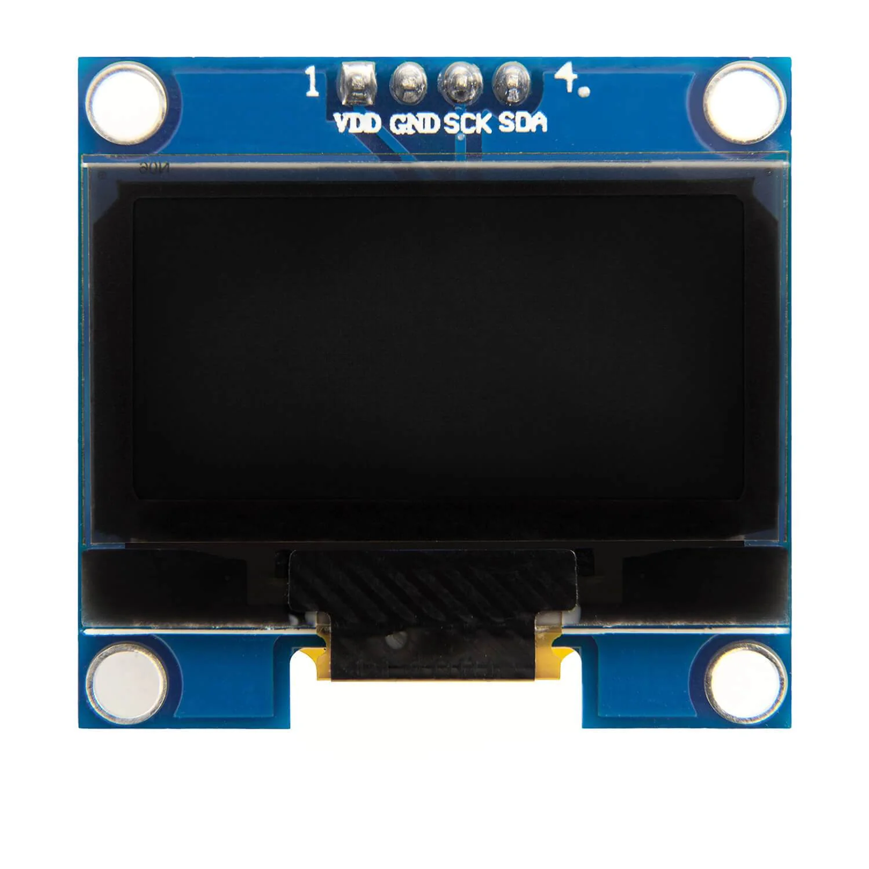
OLED Display
OLED displays have many outstanding characteristics:
very saturated, vivid colors.
deepest black, highest contrast ratio.
a wide viewing angle (180°)
low power consumption.
extremely thin form factor, flexible.
response time in microseconds for very crisp motion picture quality and 3D applications.

Slide 8
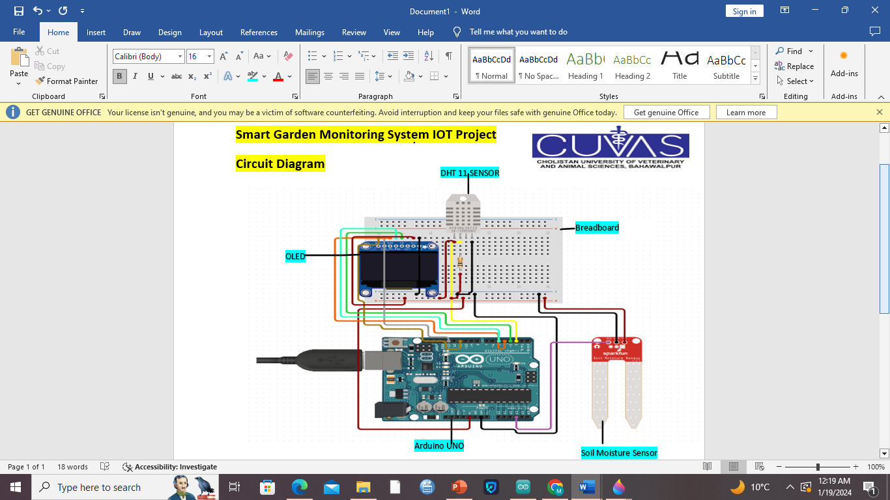

Slide 9
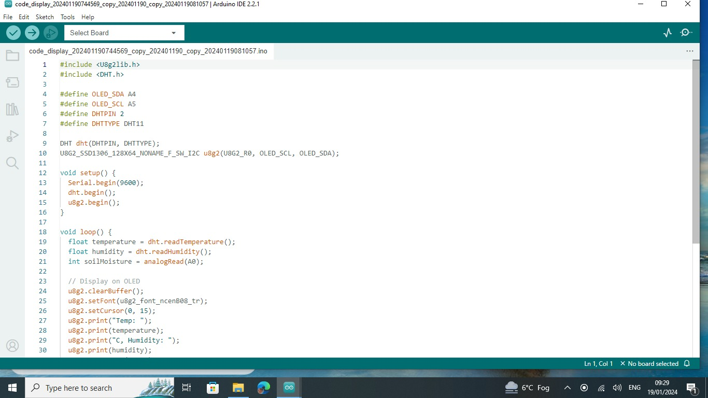

Slide 10
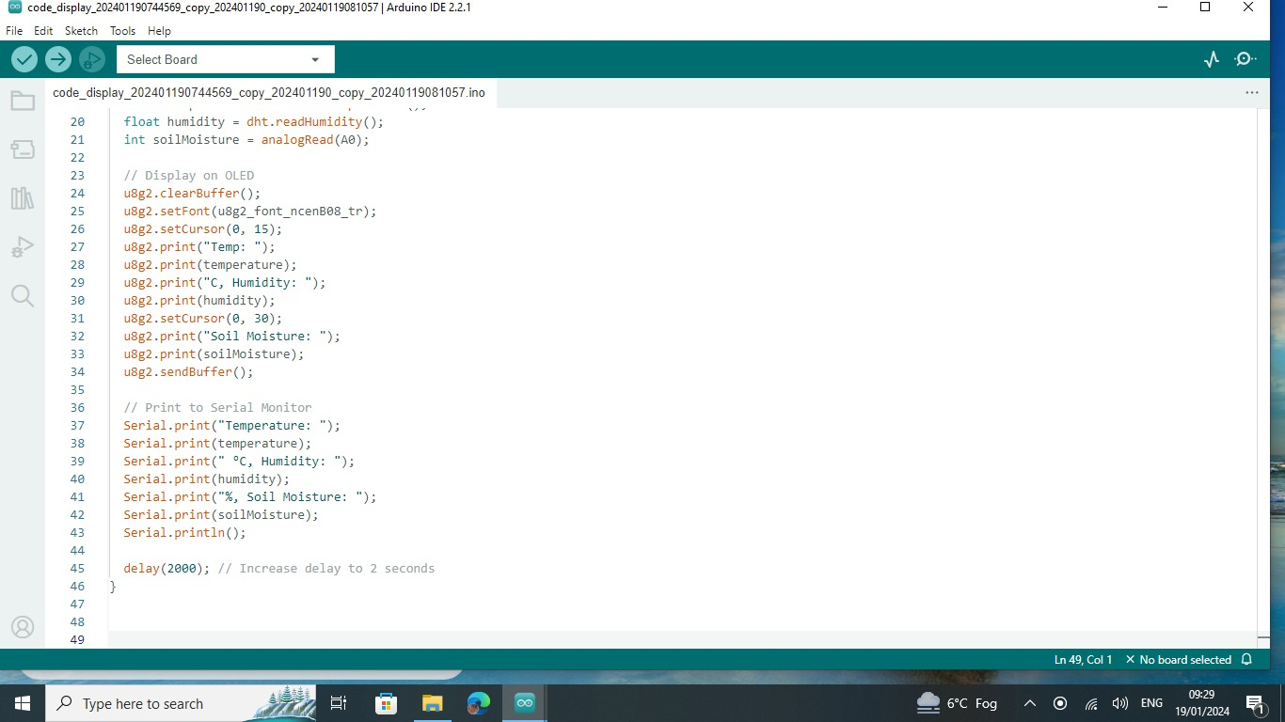

Slide 11
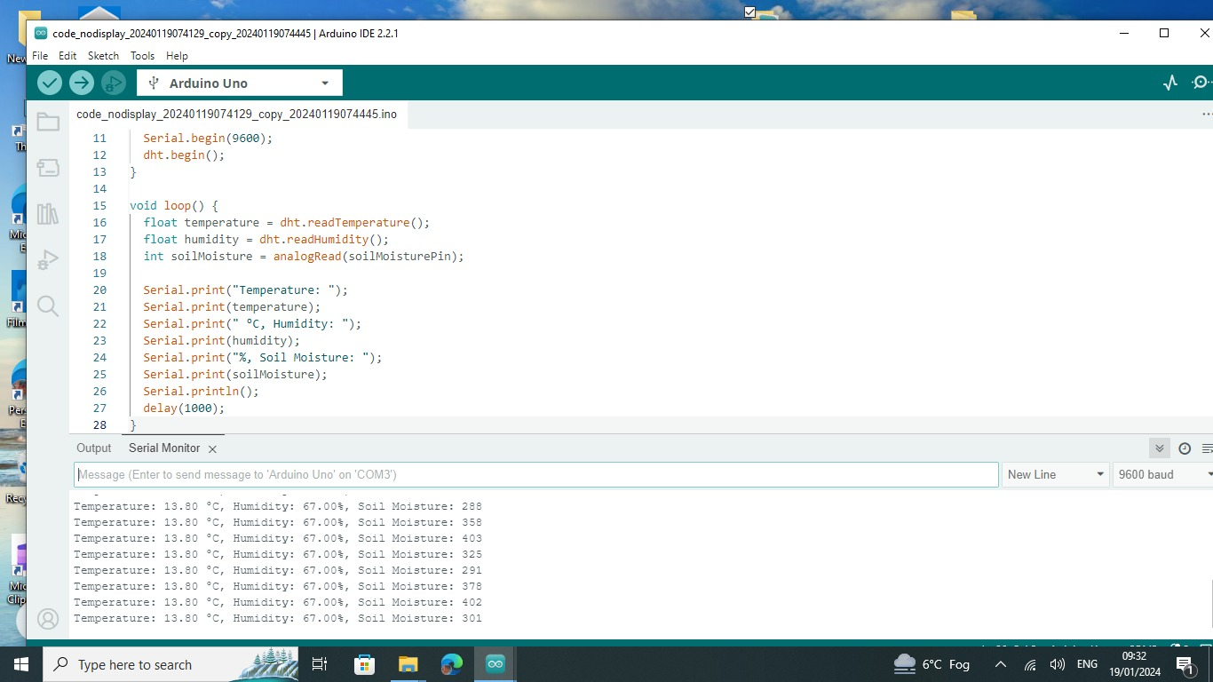

Slide 12
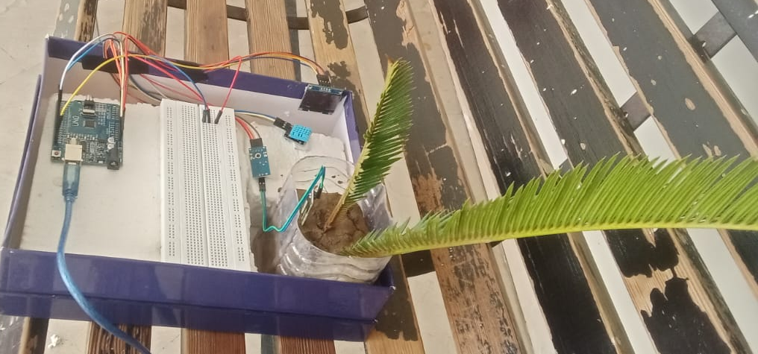
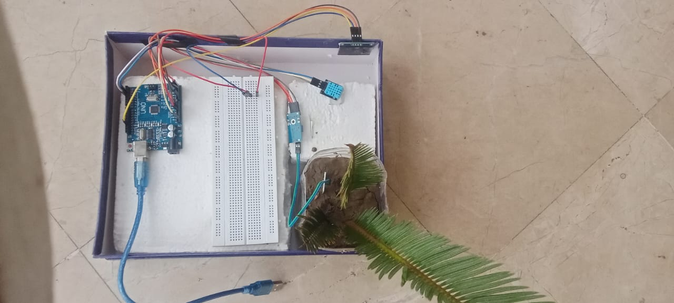
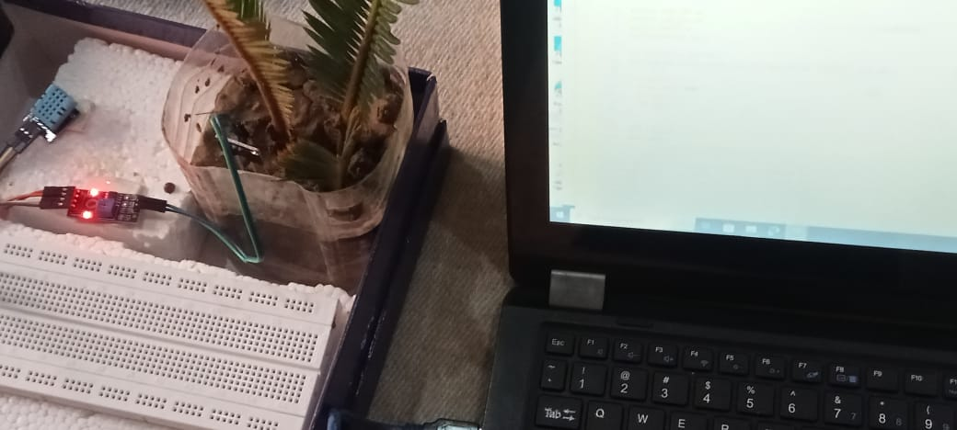
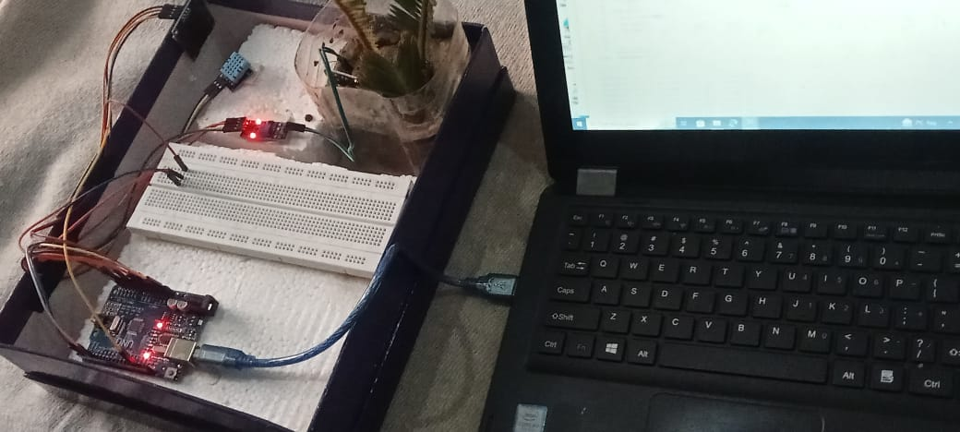

Slide 13
